Slide 1
Code Analysis Tools and Tips (How to make your code ROCK!)
Darryl Parks

Slide 2
This Presentation is About
About Code Analysis, not Run-Time monitoring
This Presentation is NOT about Performance Analysis Tools
Profiling
Jconsole or other Dynamic Memory Monitoring
Debugging Tools

Slide 3
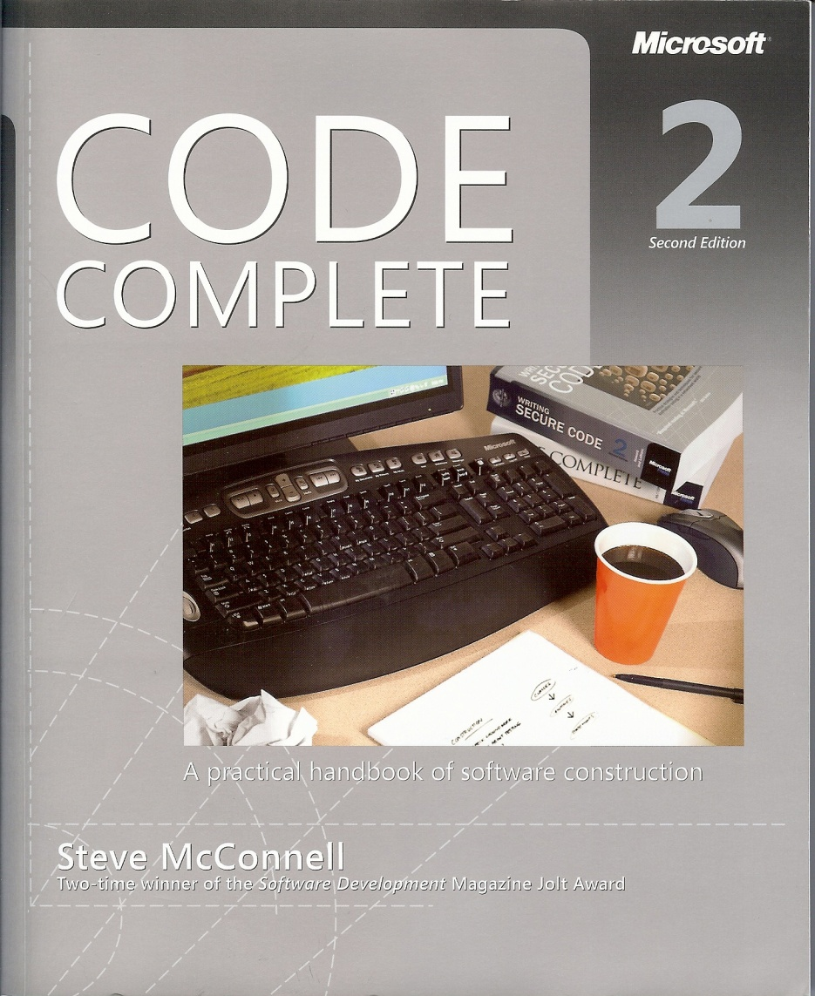
Main Source of Information for Studies
First edition honored by Software Development Magazine’s Jolt Award for product excellence.
Praised by Martin Fowler, Grady Booch, Alan Cooper and many others.

Slide 4
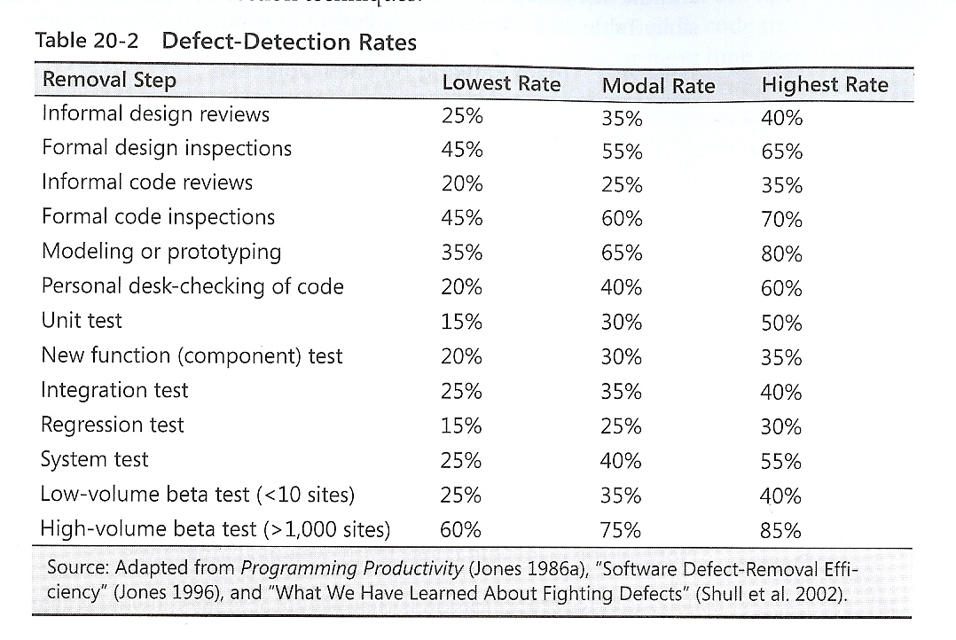
Comparison of Defect-Detection Approaches

Slide 5
Cost of Finding Defects
Most studies have found that inspections are cheaper than testing. A study at the Soft­ware Engineering Laboratory found that code reading detected about 80 percent more faults per hour than testing (Basili and Selby 1987).
Another organization found that it cost six times as much to detect design defects by using testing as by using inspections (Ackerman, Buchwald, and Lewski 1989).
A later study at IBM found that only 3.5 staff hours were needed to find each error when using code inspections, whereas 15-25 hours were needed to find each error through testing (Kaplan 1995).

Slide 6
What Results Can You Expect from Inspections?
The combination of design and code inspections usually removes 70-85 percent or more of the defects in a product (Jones 1996).
Designers and coders learn to improve their work through participating in inspections, and inspections increase productivity by about 20 percent (Fagan 1976, Humphrey 1989, Gilb and Graham 1993, Wiegers 2002).
On a project that uses inspections for design and code, the inspections will take up about 10-15 percent of project budget and will typically reduce overall project cost.

Slide 7
Best Results – Combine Approaches
The typical organization uses a test-heavy defect-removal approach and achieves only about 85 percent defect­ removal efficiency.
Leading organizations use a wider variety of techniques and achieve defect-removal efficiencies of 95 percent or higher (Gones 2000).

Slide 8
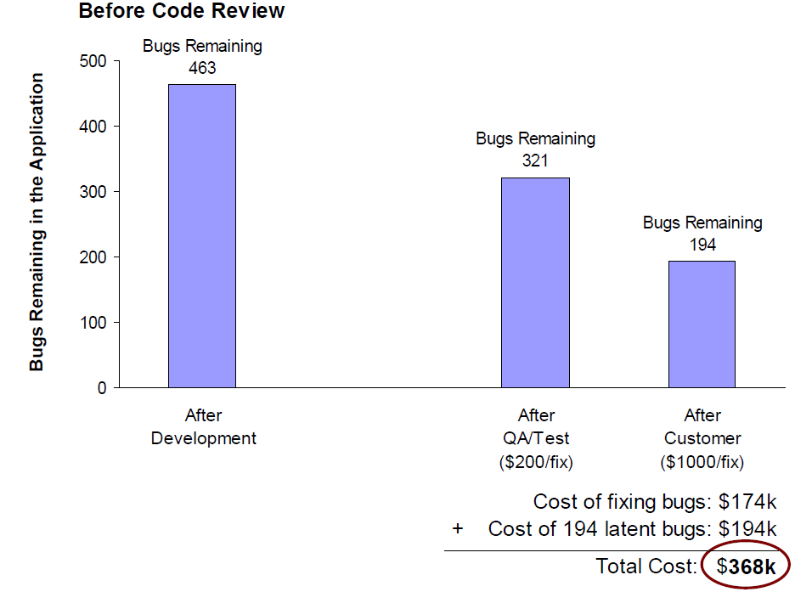
Saving $150k: A real-world case study

Slide 9
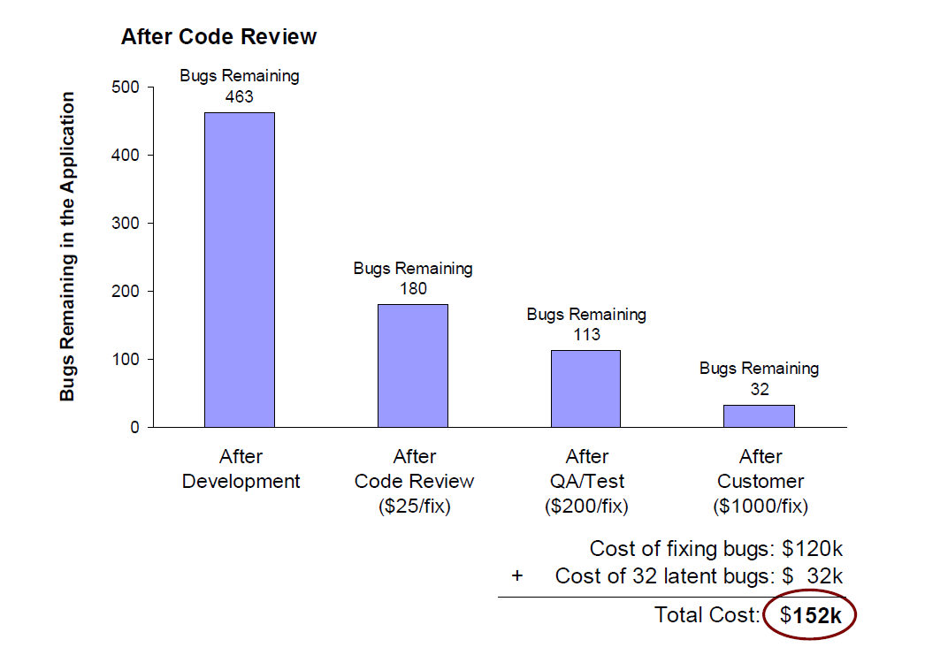
Saving $150k: A real-world case study

Slide 10
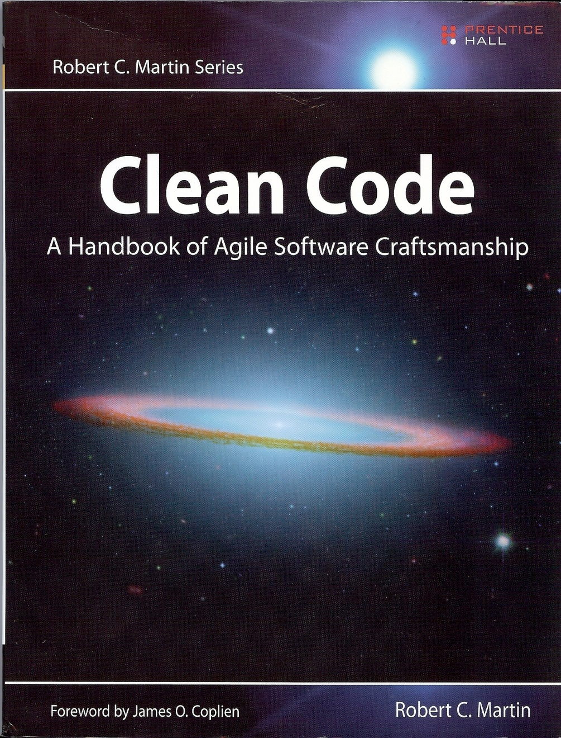
Purpose:
Is code up to quality standards?
A forum to discuss and learn from everyone.
http://www.objectmentor.com/resources/publishedArticles.html

Slide 11
Code Review Tools
Advantages of Code Review Tools
Track suggestions
Allow follow up on tasks
Aid in comparing before and after changes
Source Code repository integration
List of available tools:
Crucible
CodeCollaborator (smartbear.com) *Good reading material
http://ostatic.com/blog/open-source-code-review-tools
Review BoardTM
Rietveld
Code Striker

Slide 12
Code Review Issues
Time Consuming
Belittling
Boring
Embarrassing
Maybe “Rubber Stamping”

Slide 13
Code Analysis (Automated Code Reviews)
FindBugs
PMD
CheckStyle
Jdepend
Ckjm
Cpd
Javancss
Cobertura
Jxr - JXR is a source cross reference generator.
Javadoc

Slide 14
FindBugs
Based on the concept of bug patterns. A bug pattern is a code idiom that is often an error.
Difficult language features
Misunderstood API methods
Misunderstood invariants when code is modified during maintenance
Garden variety mistakes: typos, use of the wrong boolean operator
FindBugs uses static analysis to inspect Java bytecode for occurrences of bug patterns.
Static analysis means that FindBugs can find bugs by simply inspecting a program's code: executing the program is not necessary.
FindBugs works by analyzing Java bytecode (compiled class files), so you don't even need the program's source code to use it.
FindBugs can report false warnings, not indicate real errors. In practice, the rate of false warnings reported by FindBugs is less than 50%.

Slide 15
FindBugs Categories
Bad practice
Correctness
Dodgy
Experimental
Internationalization
Malicious code vulnerability
Multithreaded correctness
Performance
Security

Slide 16
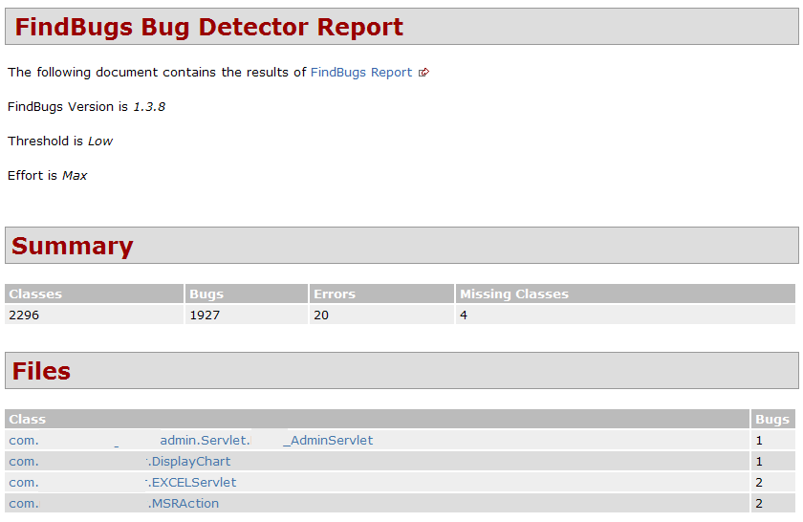
FindBugs Report

Slide 17
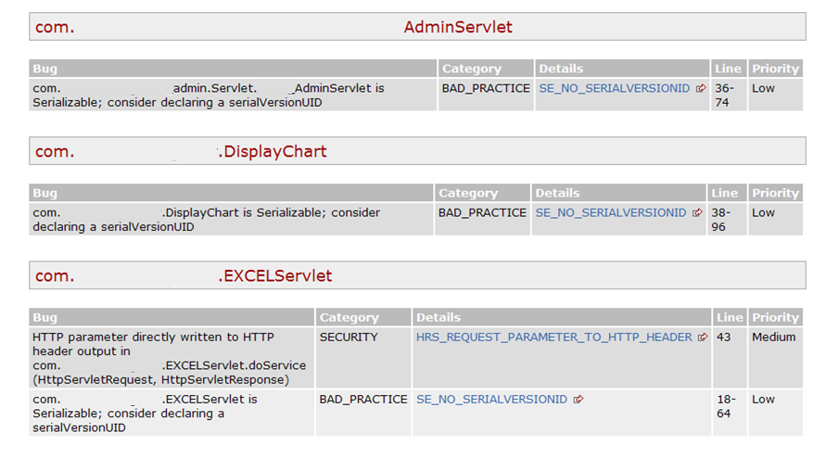
FindBugs Detail

Slide 18
PMD
PMD scans Java source code and looks for potential problems like:
Possible bugs - empty try/catch/finally/switch statements
Dead code - unused local variables, parameters and private methods
Suboptimal code - wasteful String/StringBuffer usage
Overcomplicated expressions - unnecessary if statements, for loops that could be while loops
Duplicate code - copied/pasted code means copied/pasted bugs

Slide 19
PMD RuleSets
Android Rules: These rules deal with the Android SDK.
Basic JSF rules: Rules concerning basic JSF guidelines.
Basic JSP rules: Rules concerning basic JSP guidelines.
Basic Rules: The Basic Ruleset contains a collection of good practices which everyone should follow.
Braces Rules: The Braces Ruleset contains a collection of braces rules.
Clone Implementation Rules: The Clone Implementation ruleset contains a collection of rules that find questionable usages of the clone() method.
Code Size Rules: The Code Size Ruleset contains a collection of rules that find code size related problems.
Controversial Rules: The Controversial Ruleset contains rules that, for whatever reason, are considered controversial.
Coupling Rules: These are rules which find instances of high or inappropriate coupling between objects and packages.
Design Rules: The Design Ruleset contains a collection of rules that find questionable designs.
Import Statement Rules: These rules deal with different problems that can occur with a class' import statements.
J2EE Rules: These are rules for J2EE
JavaBean Rules: The JavaBeans Ruleset catches instances of bean rules not being followed.
JUnit Rules: These rules deal with different problems that can occur with JUnit tests.
Jakarta Commons Logging Rules: Logging ruleset contains a collection of rules that find questionable usages.
Java Logging Rules: The Java Logging ruleset contains a collection of rules that find questionable usages of the logger.
Migration Rules: Contains rules about migrating from one JDK version to another.
Migration15: Contains rules for migrating to JDK 1.5
Naming Rules: The Naming Ruleset contains a collection of rules about names - too long, too short, and so forth.
Optimization Rules: These rules deal with different optimizations that generally apply to performance best practices.
Strict Exception Rules: These rules provide some strict guidelines about throwing and catching exceptions.
String and StringBuffer Rules: Problems that can occur with manipulation of the class String or StringBuffer.
Security Code Guidelines: These rules check the security guidelines from Sun.
Type Resolution Rules: These are rules which resolve java Class files for comparisson, as opposed to a String
Unused Code Rules: The Unused Code Ruleset contains a collection of rules that find unused code.

Slide 20
PMD Rule Example
PMD Basic Rules
EmptyCatchBlock: Empty Catch Block finds instances where an exception is caught, but nothing is done. In most circumstances, this swallows an exception which should either be acted on or reported.
EmptyIfStmt: Empty If Statement finds instances where a condition is checked but nothing is done about it.
EmptyWhileStmt: Empty While Statement finds all instances where a while statement does nothing. If it is a timing loop, then you should use Thread.sleep() for it; if it's a while loop that does a lot in the exit expression, rewrite it to make it clearer.
EmptyTryBlock: Avoid empty try blocks - what's the point?
EmptyFinallyBlock: Avoid empty finally blocks - these can be deleted.
EmptySwitchStatements: Avoid empty switch statements.
JumbledIncrementer: Avoid jumbled loop incrementers - it's usually a mistake, and it's confusing even if it's what's intended.
ForLoopShouldBeWhileLoop: Some for loops can be simplified to while loops - this makes them more concise.

Slide 21
Maven PMD Configuration
<project>
...
<reporting>
<plugins>
<plugin>
<groupId>org.apache.maven.plugins</groupId> <artifactId>maven-pmd-plugin</artifactId>
</plugin>
</plugins>
</reporting>
...
</project>

Slide 22
PMD Configuration
<reporting>
<plugins>
<plugin>
<groupId>org.apache.maven.plugins</groupId>
<artifactId>maven-pmd-plugin</artifactId>
<configuration>
<rulesets>
<ruleset>/rulesets/braces.xml</ruleset>
<ruleset>/rulesets/naming.xml</ruleset>
<ruleset>d:\rulesets\strings.xml</ruleset>
<ruleset>http://localhost/design.xml</ruleset>
</rulesets>
</configuration>
</plugin>
</plugins>
</reporting>

Slide 23
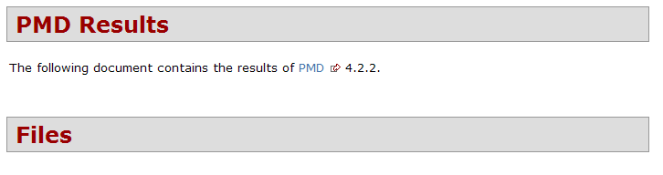
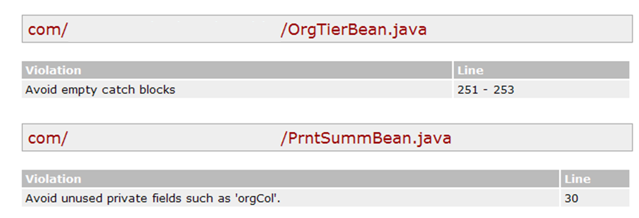
PMD Example Report

Slide 24
CheckStyle
Development tool to help programmers write Java code that adheres to a coding standard. It automates the process of checking Java code to spare humans of this boring (but important) task.
Highly configurable and can be made to support almost any coding standard. An example configuration file is supplied supporting the Sun Code Conventions. Other sample configuration files are supplied for other well known conventions.

Slide 25
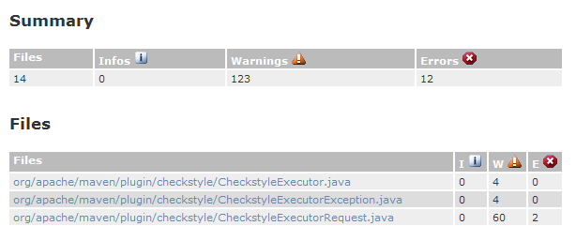
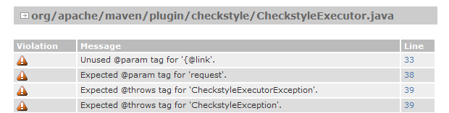
CheckStyle Example

Slide 26
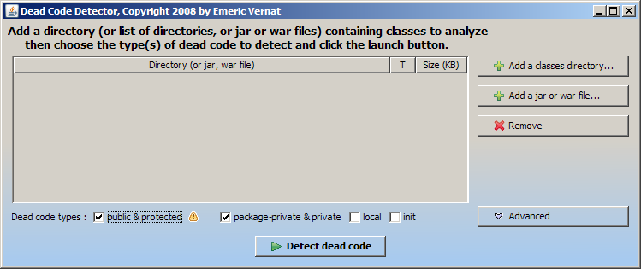
Dead Code Detector

Slide 27
Miscellaneous Tools
CKJM - Chidamber and Kemerer Java Metrics
Cobertura & EMMA – Test Code Coverage
JavaNCSS - A Source Measurement Suite
JDepend – Package Dependencies; Efferent Couplings (Ce) (number of other packages that the classes in the package depend upon)
PMD-CPD - Copy/Paste Detector (CPD)
Java2HTML - Source Code turned into a colorized and browseable HTML representation.

Slide 28
Structure Tools
Struture101 -- For understanding, analyzing, measuring and controlling the quality of your Software Architecture as it evolves over time.
Sotoarc/Sotograph — Architecture and quality in-depth analysis and monitoring for Java,
http://en.wikipedia.org/wiki/List_of_tools_for_static_code_analysis

Slide 29
XRadar
XRadar is an open extensible code report tool currently supporting all Java based systems.
The batch-processing framework produces HTML/SVG reports of the systems current state and the development over time - all presented in sexy tables and graphs.
It gets results from several brilliant open source projects and a couple of in house grown projects and presents the results as massive unified html/svg reports.

Slide 30
Xradar – MVN Site
<reporting>
<plugins>
<plugin>
<groupId>net.sf.xradar</groupId>
<artifactId>maven-xradar-plugin</artifactId>
<version>1.2.2</version>
</plugin>
</plugins>
</reporting>

Slide 31
Xradar
DEMO

Slide 32
Sonar
Dashboard to summarize Static and Dynamic analysis Tools.
Conventions (Checkstyle)
Bad Practices (PMD)
Potential Bugs (FindBugs)

Slide 33
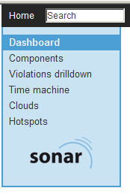
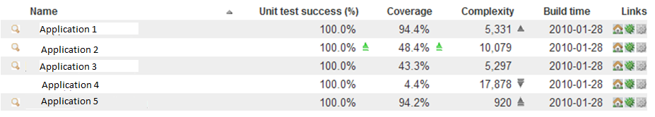
Sonar Example – Front Dashboard

Slide 34
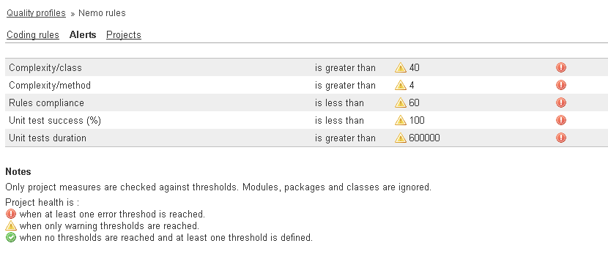
Sonar Setting Alerts

Slide 35
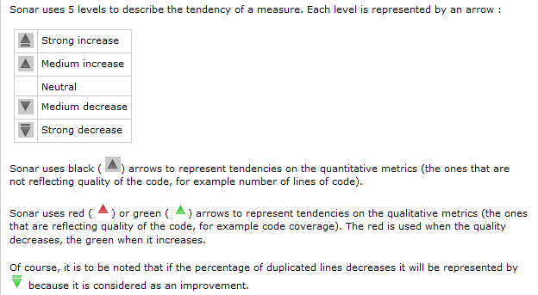
Reading Sonar Tendencies

Slide 36
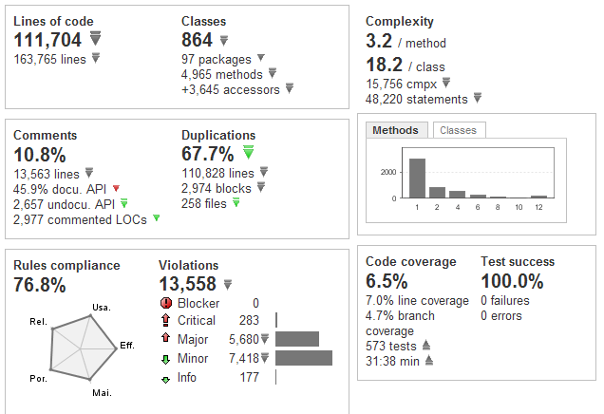
Sonar Application Dashboard

Slide 37
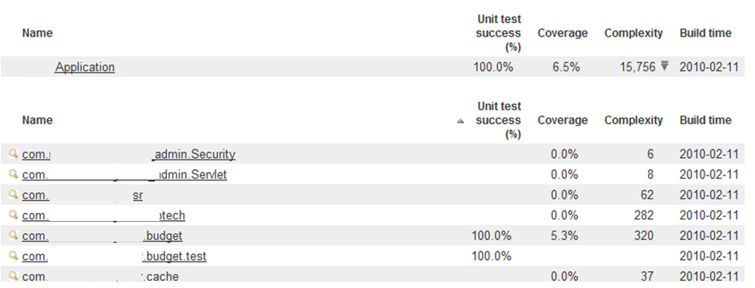
Sonar Components

Slide 38
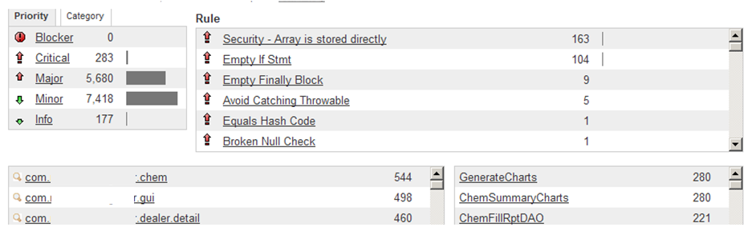
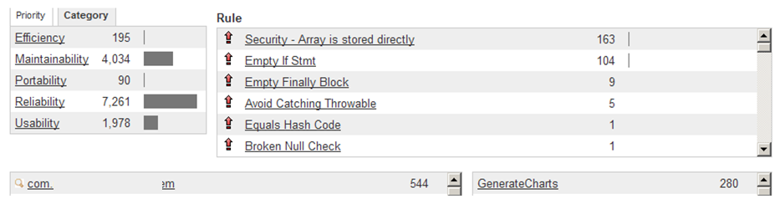
Sonar Violations Drilldown

Slide 39
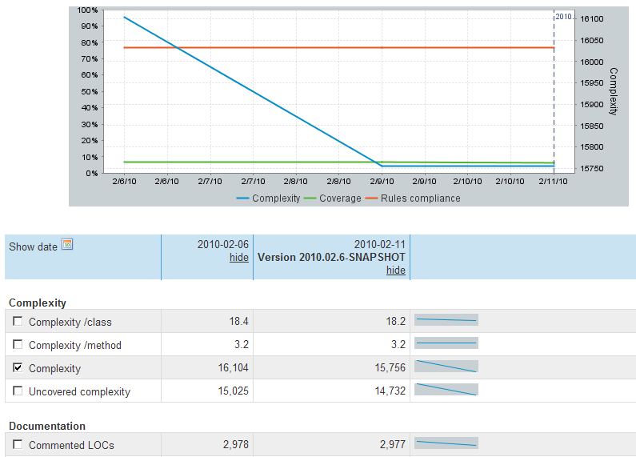
Sonar Time Machine

Slide 40
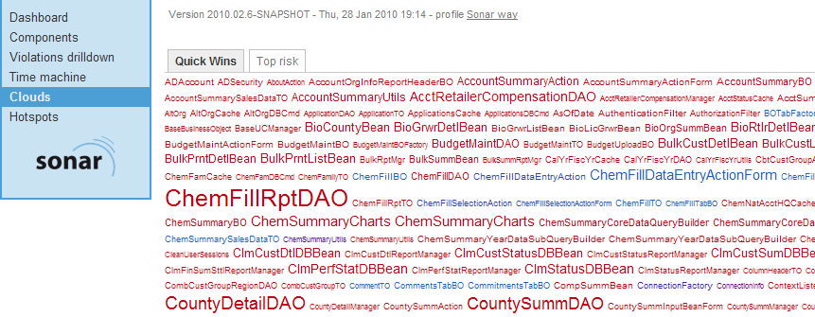
Sonar - Clouds

Slide 41
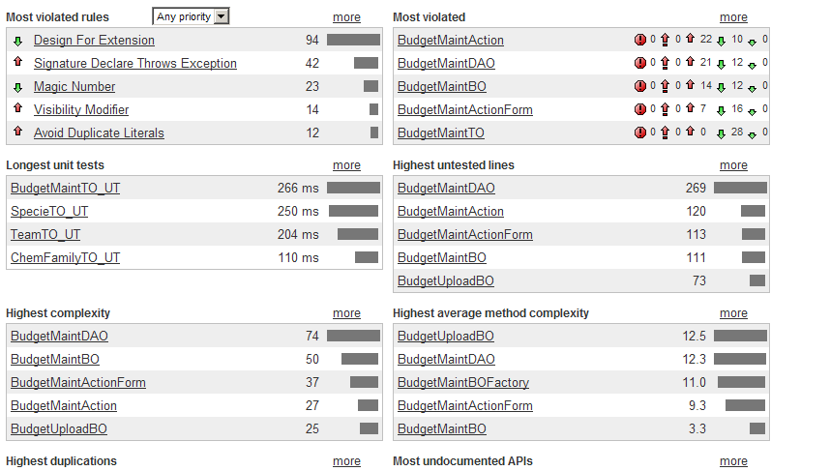
Sonar Hotspots

Slide 42
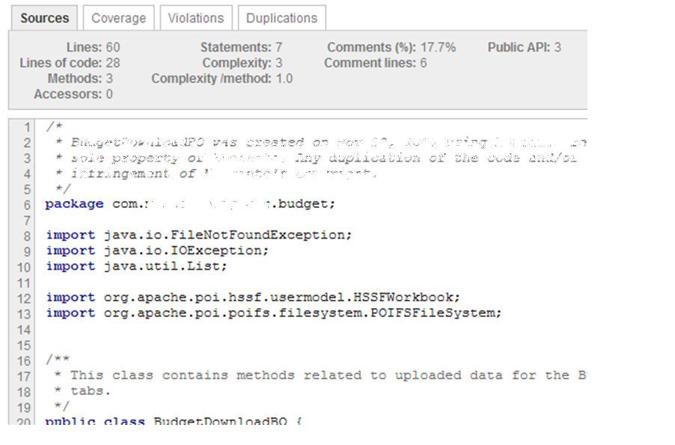
Sonar Drilldown

Slide 43
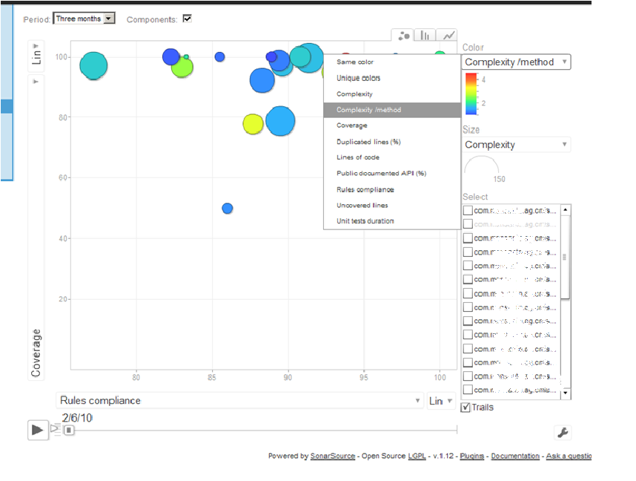
Sonar Plug-In Motion Chart

Slide 44
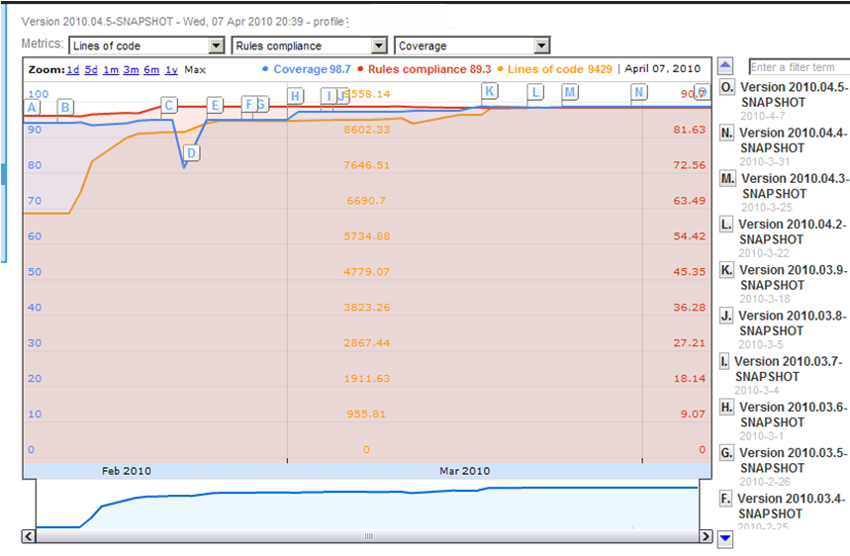
Sonar Plug-In Timeline

Slide 45
My Other Favorite Code Analysis Tool (IntelliJ)
Very easy to use
Comes in a free version
Easy to install
Is a Third Generation Tool

Slide 46
IntelliJ Idea
IDE Features | Community Edition | Ultimate Edition
Code Duplicates | No | Yes
Code Coverage | No | Yes
Code Inspector | Yes | Yes
Spell Checker | Yes | Yes
More than 600 automated Code Inspections
Finding probable bugs
Locating the “dead” code
Detecting performance issues
Improving code structure and maintainability
Conforming to coding guidelines and standards
Conforming to specifications

Slide 47
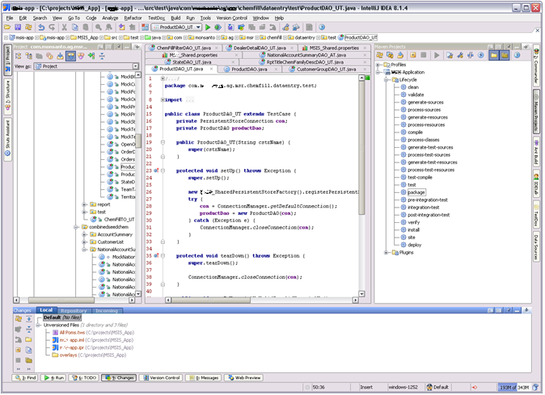
IntelliJ Idea Demo

Slide 48

Q&A

